Slide 1
Data warehouse

Slide 2
Components of Data Warehousing
Data Sources: These are the origins of data that feed the data warehouse.
Operational Databases (OLTP systems):Day-to-day transaction systems such as sales systems, banking systems, ERP, etc.Example: customer orders, payments, inventory updates.
External Data:Data coming from outside the organization.Example: market trends, social media data, government statistics.
ETL Process (Extract, Transform, Load):This is the core pipeline that prepares data for the warehouse.
Extract:Data is collected from multiple sources (databases, APIs, files).
Transform: Data is cleaned and prepared: Remove duplicates ,Fix errors ,Standardize formats ,Integrate data from different sources
Load :Processed data is stored into the data warehouse.

Slide 3
Components of Data Warehousing
Data Warehouse Storage: This is the central repository where processed data is stored. Typically implemented using relational databases. Organized using models like Star Schema and Snowflake Schema.
Data Marts: These are smaller, specialized subsets of the data warehouse. Designed for specific departments: Finance, Sales, and Marketing.It facilitate Faster access to relevant data, Improved performance and Easier for users to analyze.

Slide 4
Components of Data Warehousing
OLAP(Online Analytical Processing):It is a technology used in data warehousing that enables users to analyze large volumes of data quickly and interactively, especially for decision-making.
Slicing: Extract a single layer of the cube Example: Sales data for 2025 only
Dicing: Extract a sub-cube (more specific selection) .Example: Sales in Zanzibar for Q1 2025
Drill-Down: Move from summary detailed data .Example: Year → Month → Day
Roll-Up:Move from detailed → summarized data .Example: Daily sales → Monthly sales.

Slide 5
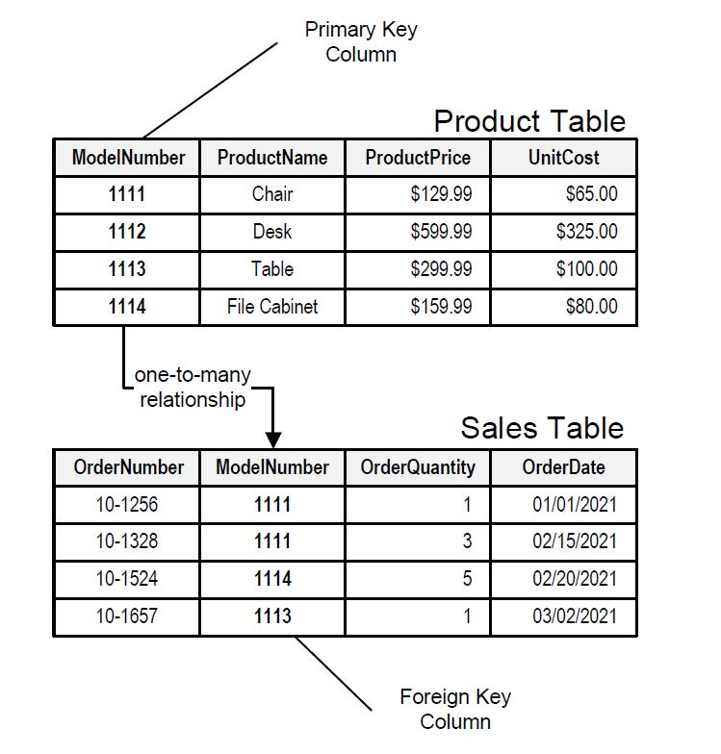
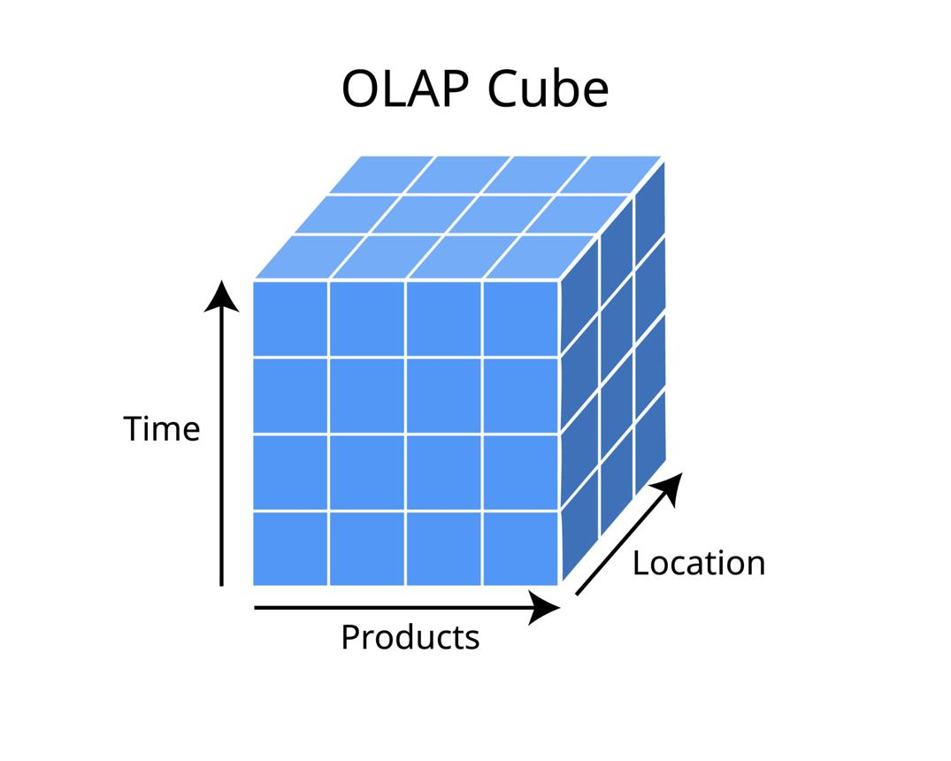
Notes:
A relational database is a type of database that stores data in the form of tables (relations).
Multidimensional OLAP (MOLAP) is a type of OLAP system that stores data in a multidimensional cube format instead of tables.

Slide 6
Data Modeling Concepts
Fact Tables: Fact tables store quantitative, measurable business data.
Characteristics:
Contains numeric values for analysis
Represents business events or transactions
Usually very large
Linked to dimension tables through foreign keys.
Dimension Tables: Dimension tables store descriptive attributes that provide context to facts.
Characteristics:
Contains textual or categorical information
Used for filtering, grouping, and labeling
Usually smaller than fact tables

Slide 7
Data Modeling Concepts
Star Schema:Star Schema is the simplest and most widely used data warehouse schema.
Structure:
One central fact table
Connected directly to multiple dimension tables
Resembles a star shape
Snowflake Schema: Snowflake Schema is an extension of the star schema with normalized dimensions.
Structure:
Fact table at center
Dimension tables split into sub-dimensions
More complex design

Slide 8
Phases of Data Warehousing Methodology
Business Requirements Analysis: This is the foundation of the entire data warehouse project.
Purpose: To understand what the organization needs from the data warehouse.
Data Source Identification: Organizations have data stored in multiple systems.
Purpose:
To determine:
Where data comes from
Data structure
Data quality
Integration difficulty

Slide 9
Phases of Data Warehousing Methodology
Data Warehouse Design: This phase determines how data will be organized.
A. Conceptual Design
High-level overview.
Focus:
Business subjects
Major entities
Data categories
B. Logical Design
Detailed relationships.
Includes:
Fact tables
Dimension tables
Schema selection
Star Schema:
Simple and direct.
Snowflake Schema:
More normalized and detailed.
C. Physical Design
Actual technical implementation.
Includes:
Database platform
Storage allocation
Partitioning
Indexes
Security controls

Slide 10
Phases of Data Warehousing Methodology
ETL Development (Extract, Transform, Load): This is one of the most critical steps.
Extract
Retrieve data from source systems.
Example:
Customer data from CRM
Sales data from POS
Transform
Prepare data for warehouse use.
Activities:
Cleaning
Removing duplicates
Standardization
Validation
Data integration
Load
Store transformed data into warehouse.
Types:
Full load
Incremental load

Slide 11
Phases of Data Warehousing Methodology
Data Warehouse Implementation:Build and deploy the designed system.
Activities:
Create tables
Configure ETL jobs
Build data marts
Establish security
Set backup systems

Slide 12
Phases of Data Warehousing Methodology
OLAP and Analytical Processing Layer: OLAP allows multidimensional analysis.
Functions:
Drill-down
Roll-up
Slice
Dice

Slide 13
Phases of Data Warehousing Methodology
Testing and Quality Assurance: Testing ensures system reliability.
Types of Testing:
Data Accuracy Testing: Ensures correct values.
ETL Testing: Ensures transformations work correctly.
Performance Testing: Ensures fast query speed.
Security Testing: Protects sensitive information.
User Acceptance Testing: End users verify requirements.

Slide 14
Phases of Data Warehousing Methodology
Deployment: Move warehouse into real business use.
Maintenance and Continuous Improvement: Data warehouses evolve with business needs.
Activities:
Add new data sources
Upgrade ETL
Optimize performance
Improve reports
Data governance

Slide 15
Assignment 01:
Differentiate between relational database and OLAP (Provides 5 differences).
Describe the architecture of data warehouse
Explain single Tier-architecture
Two tier - architecture
Three tier - architecture
Differentiate between star and snowflake schema.

